Slide 1
UI Mocks (Wireframes)

Slide 2
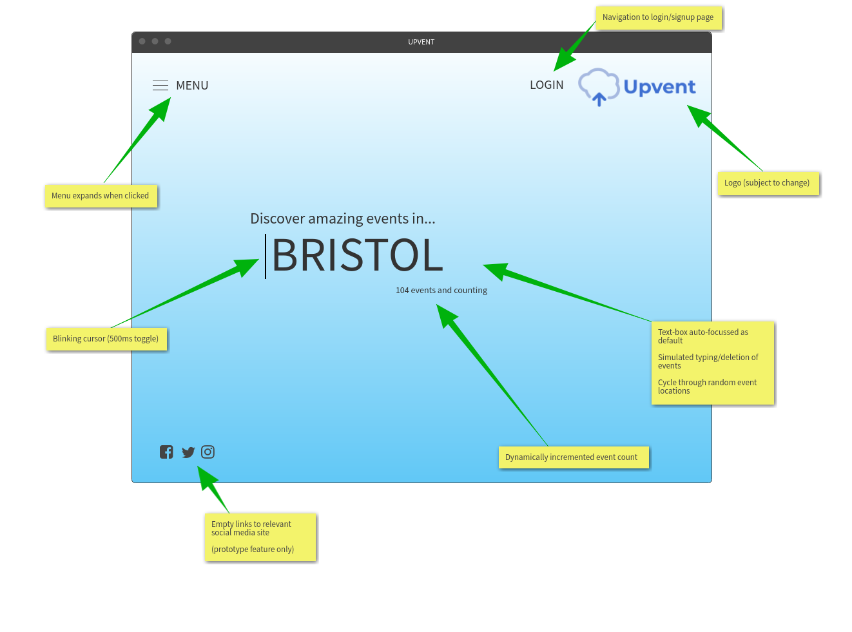
Home page

Slide 3
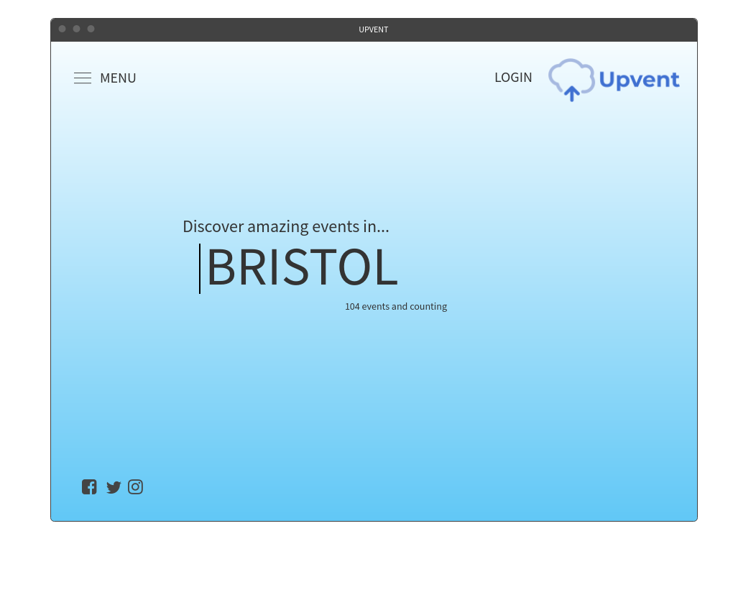
Home page

Slide 4
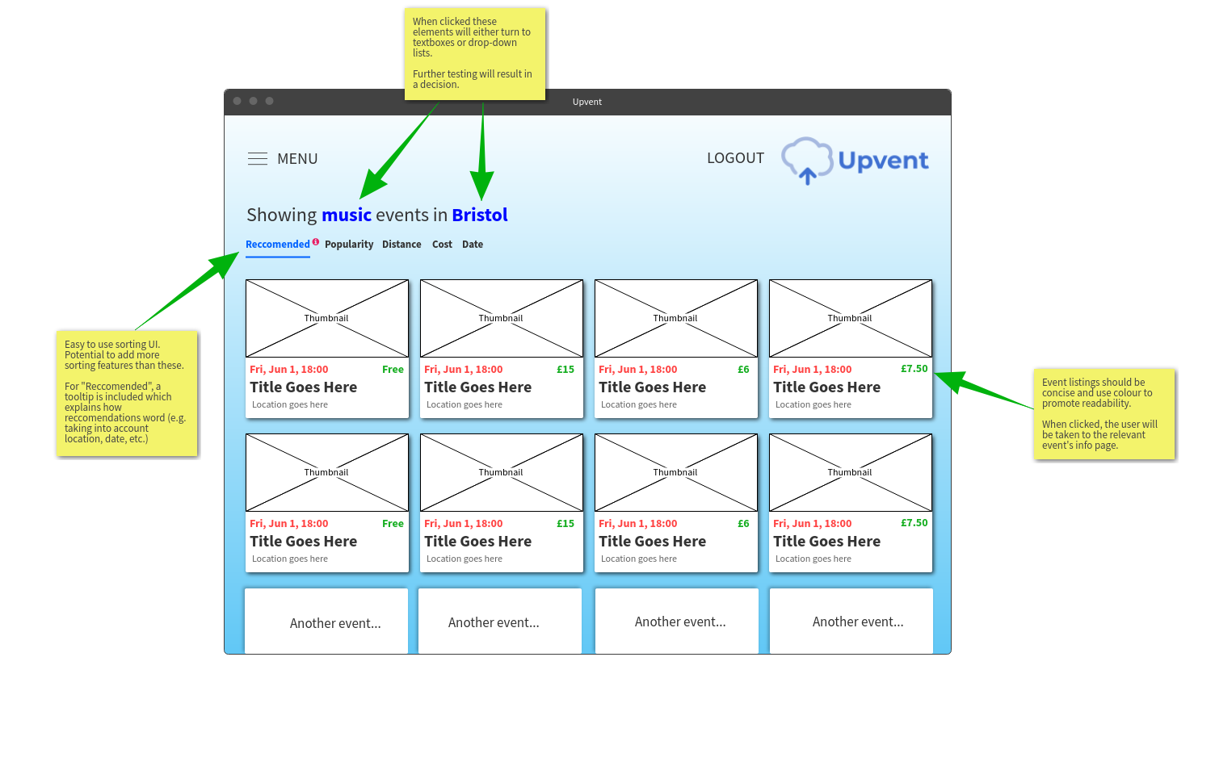
Event listing page

Slide 5
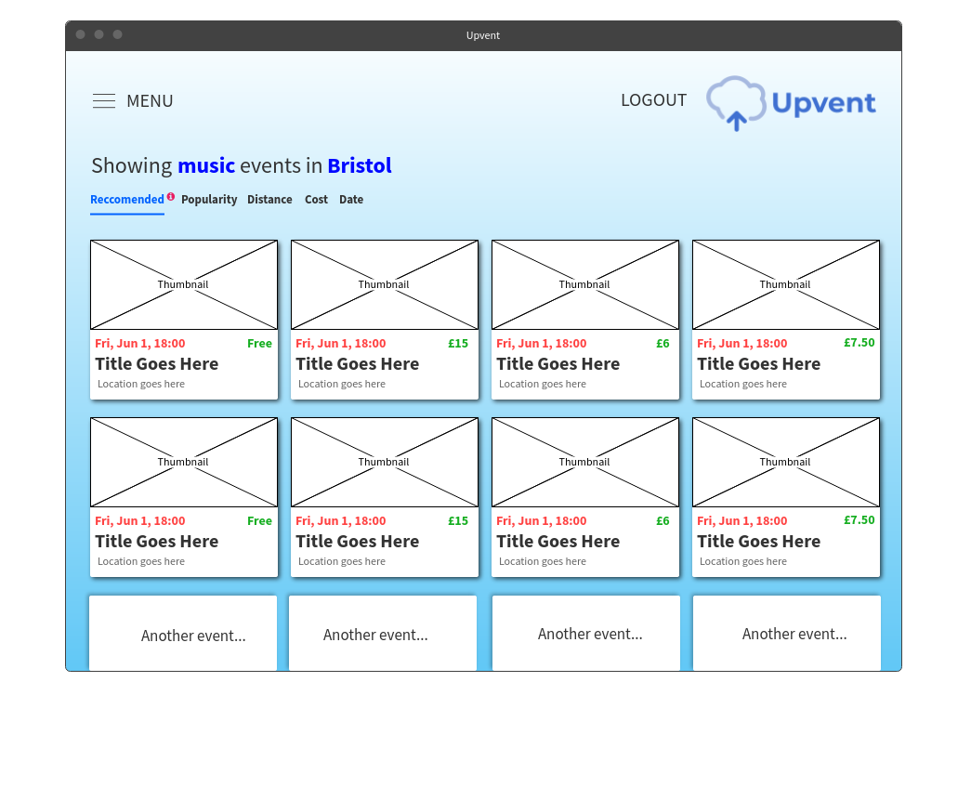
Event listing page

Slide 6
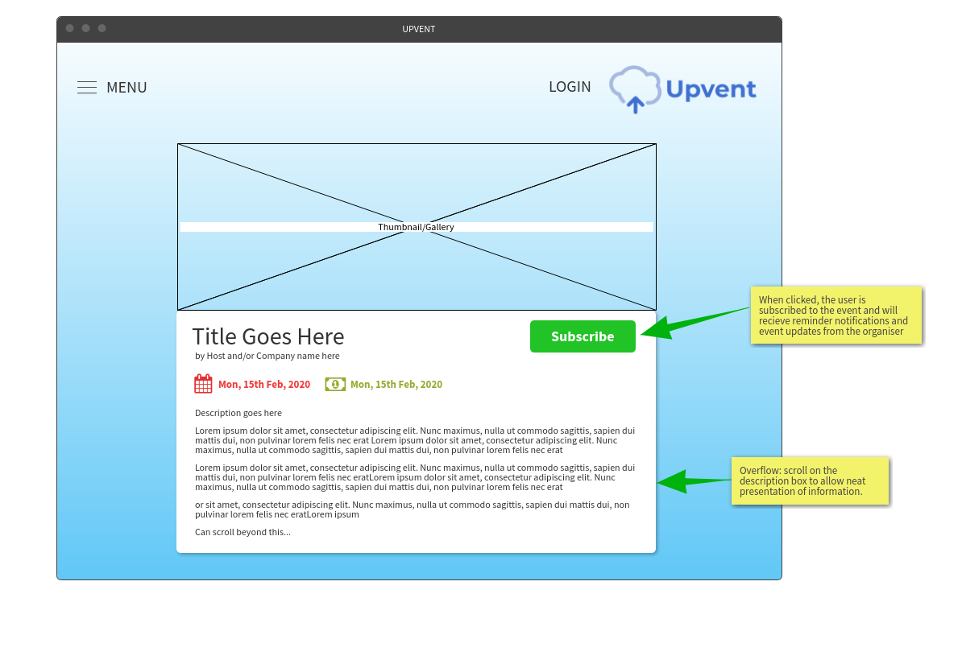
Event info page (possibly modal dialog)

Slide 7
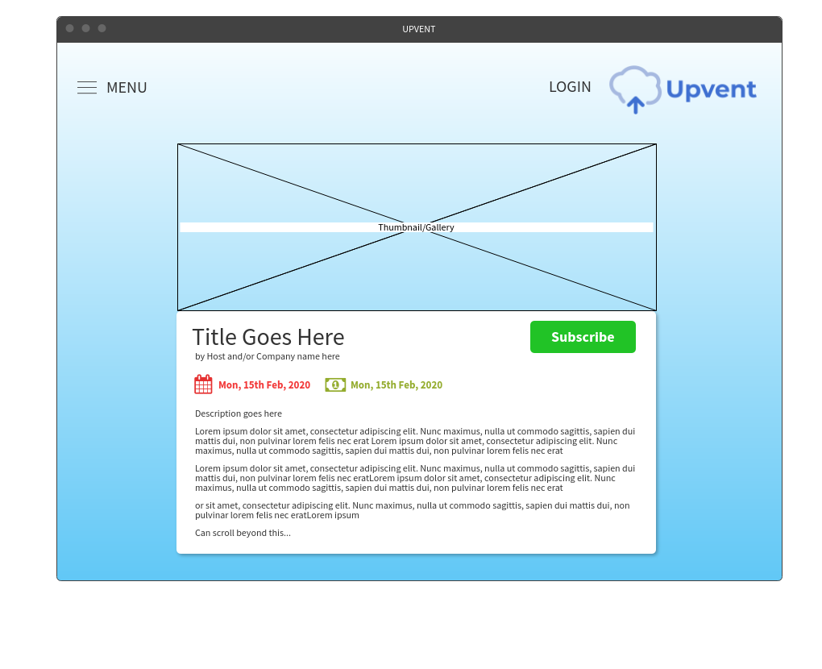
Event info page (possibly modal dialog)

Slide 8
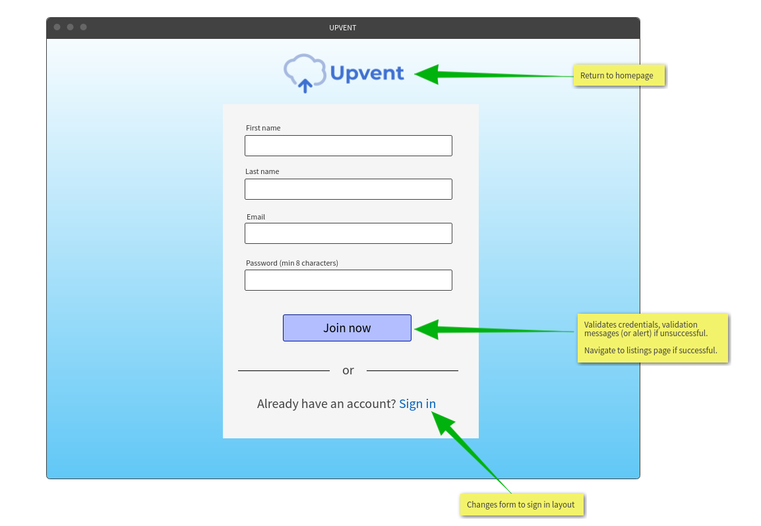
Login/Sign-up page

Slide 9
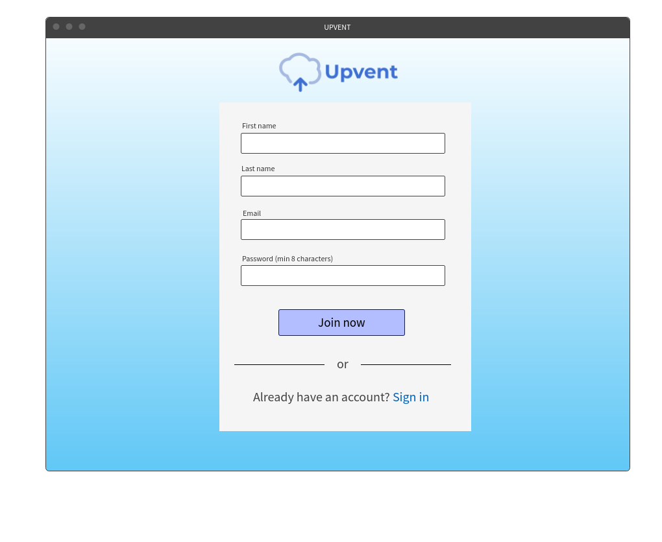
Login/Sign-up page

Slide 10
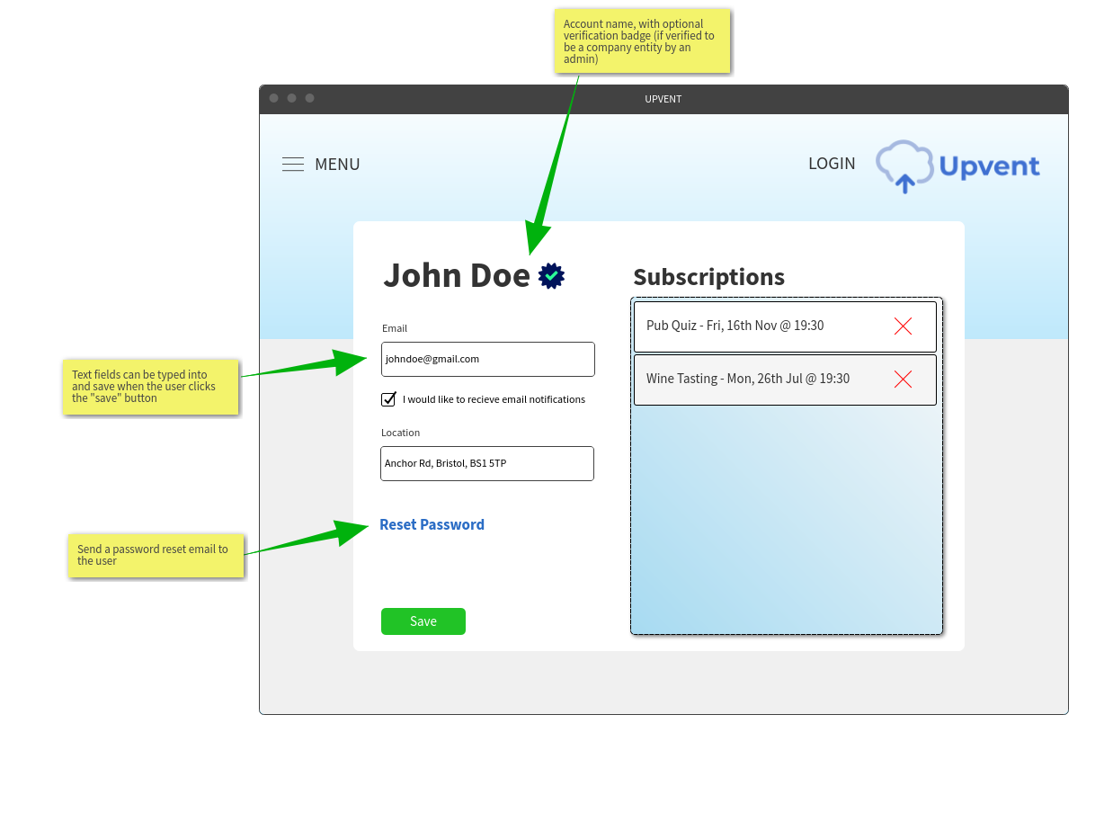
User profile page

Slide 11
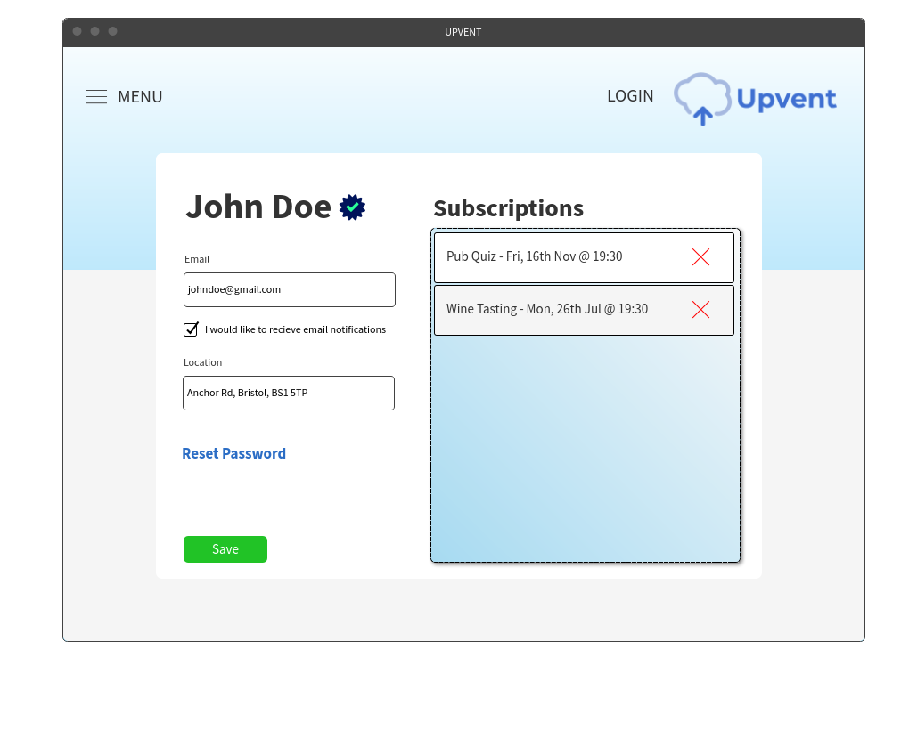
User profile page

Slide 12
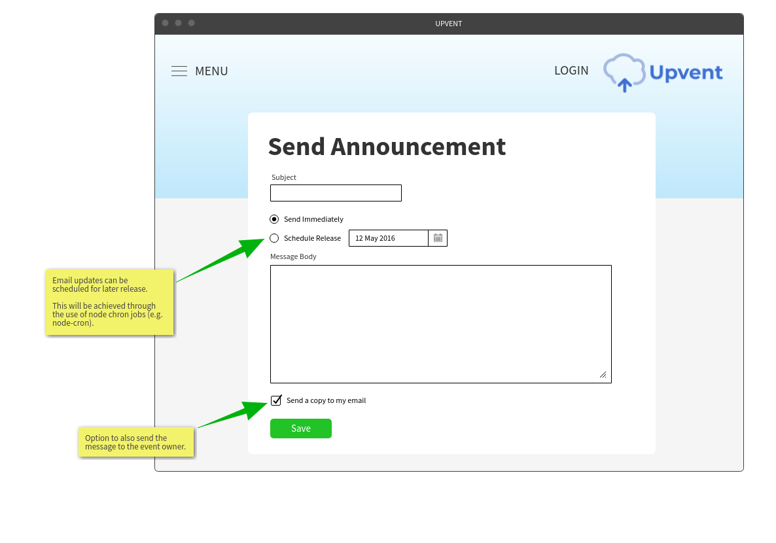
Send event update page

Slide 13
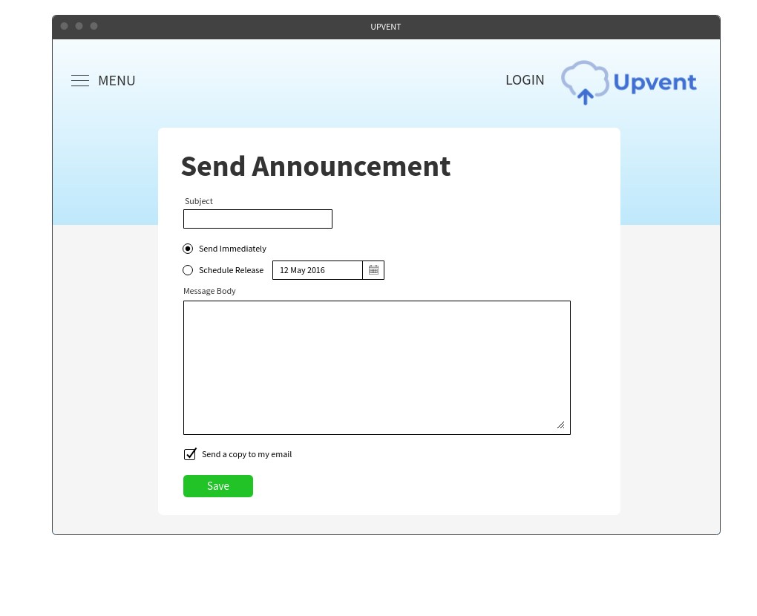
Send event update page

